Slide 1
Abo Obaida School
Adjectives
الصفات

Slide 2
happy sad

Slide 3
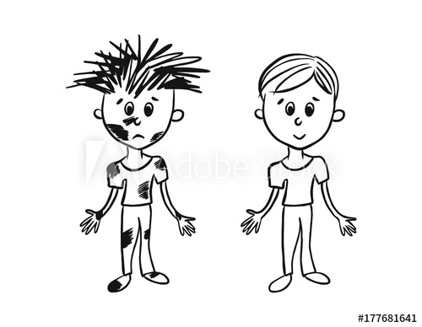
dirty clean

Slide 4
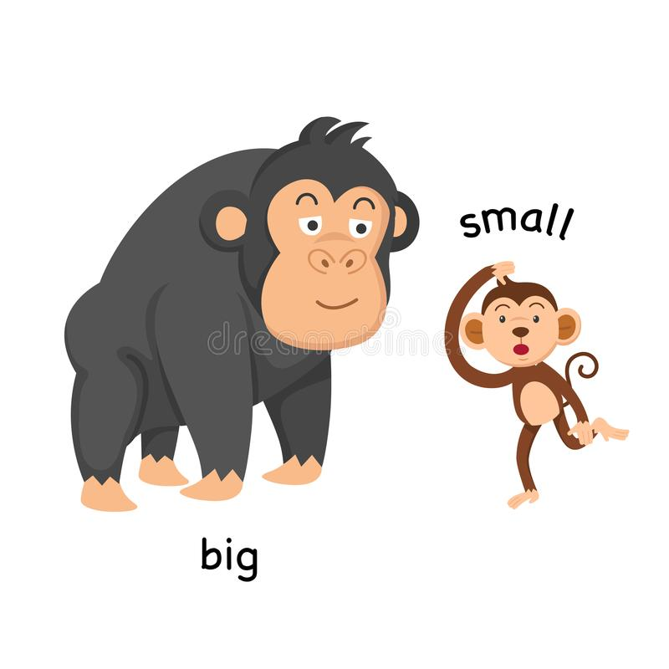

Slide 5
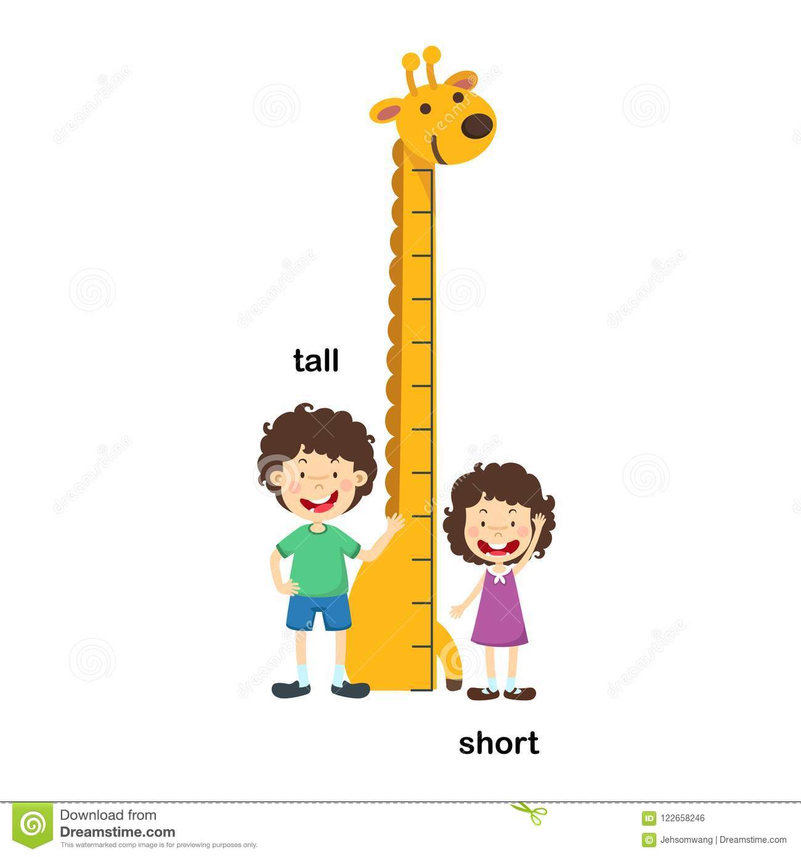

Slide 6
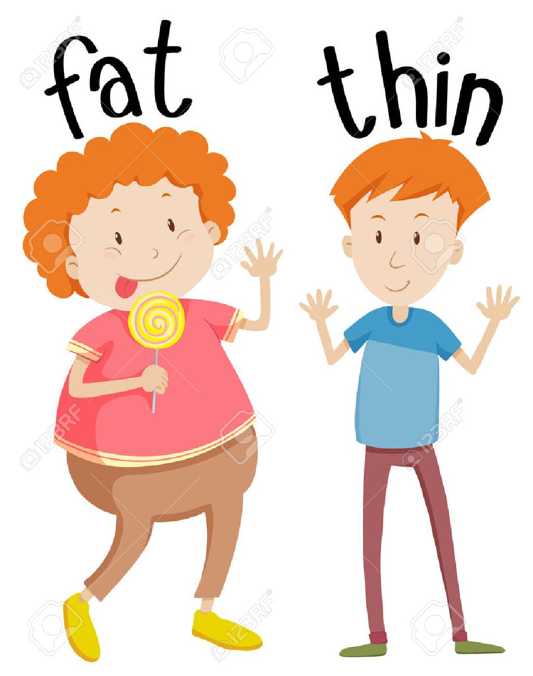

Slide 7
angry + hungry

Slide 8
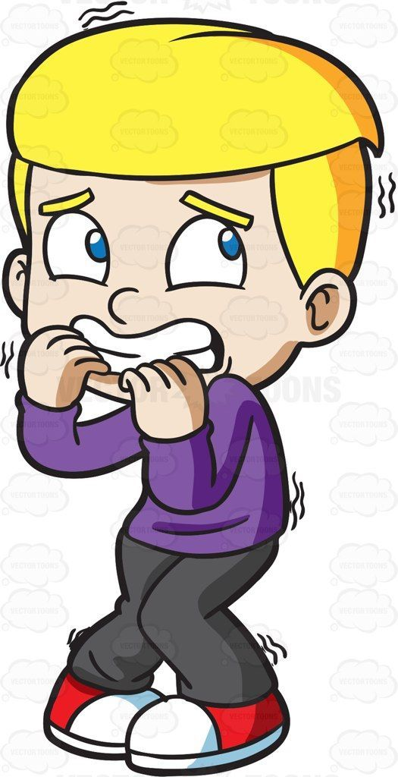
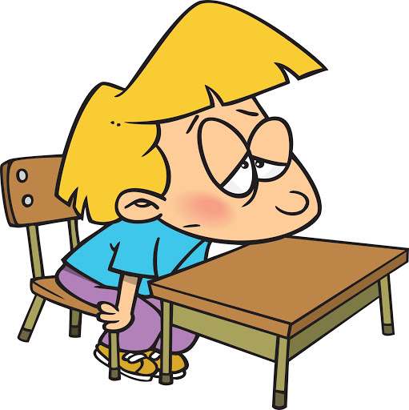
scared + tired

Slide 9
About Myself: :عن نفسي:
I am ____________.
happy - scared - tall
sad - big - short
angry - small - clean
hungry - fat - dirty
tired - thin

